Slide 1





CodHer()
By: Fatema, Sofia, Nicole and Winnie

Slide 2

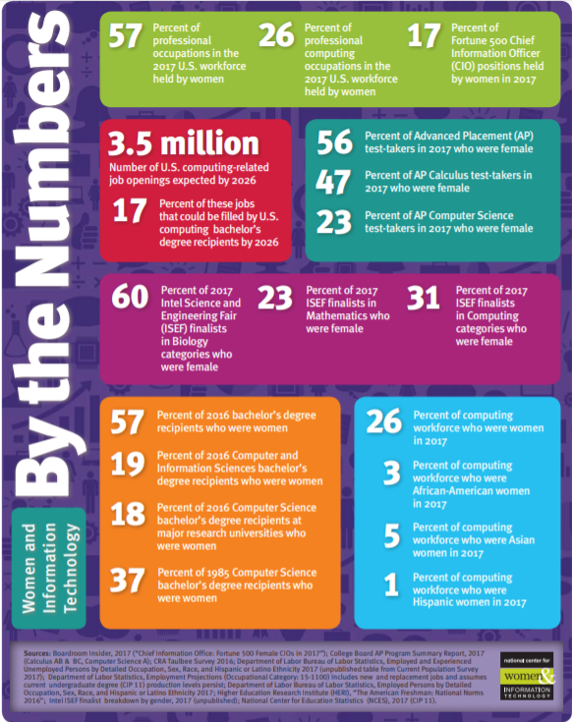
The Problem
There are a lot of stereotypes that STEM careers are for men
Young women do not have a lot of easy access to technology education
Women generally believe tech related fields would be too difficult for them
CodHer()

Slide 3
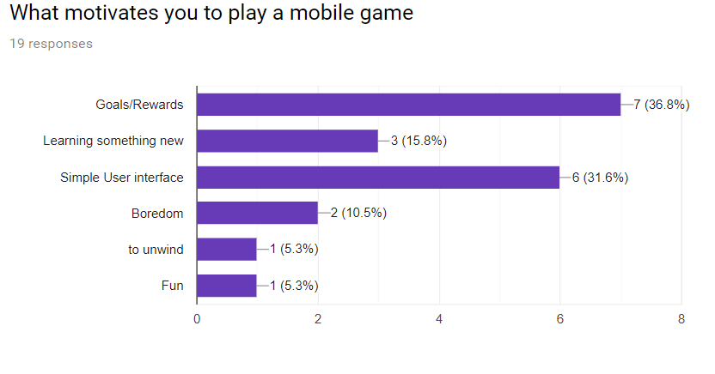
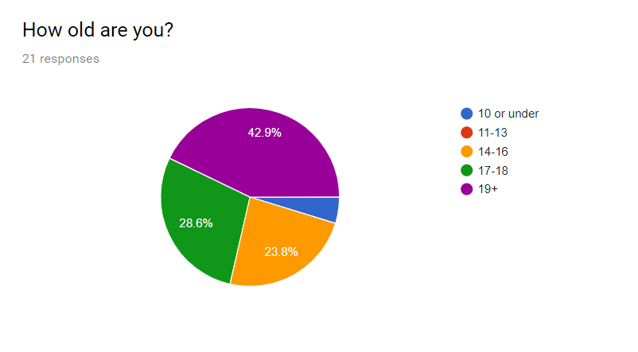
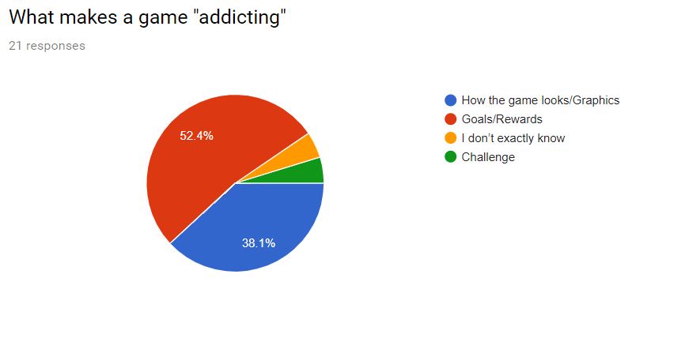
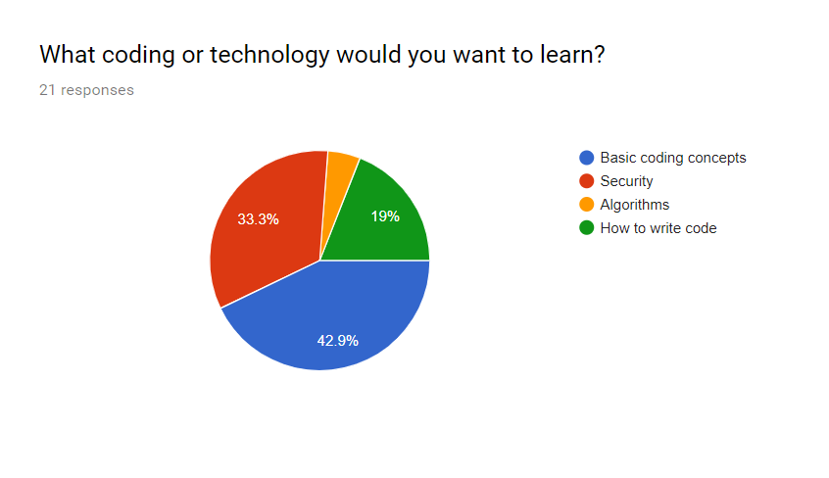
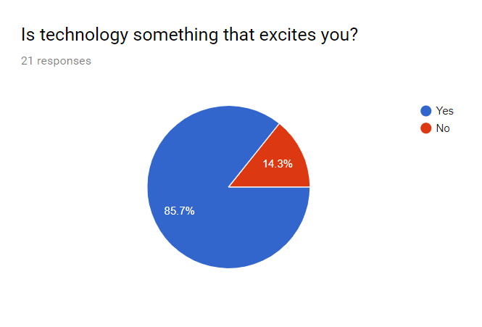
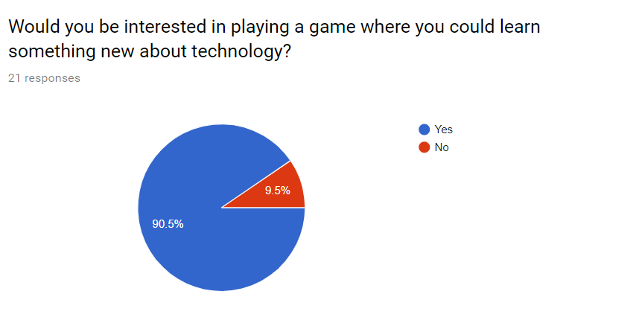
Our Research:
CodHer()

Slide 4



Solution: CodHer()
CodHer is a mobile application created by women for women!
CodHer is an exciting game that allows users to complete challenges and level up based on their coding abilities
Choose your avatar, skateboard to the end of the
course and avoid all the obstacles to complete the
challenge and level up!
X = "Hello World" What Data Type is X? A. String B. Integer C. Boolean D. Char

Slide 5
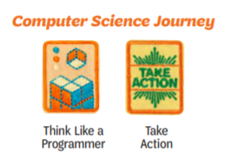
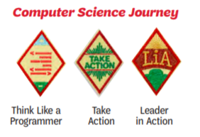
CodHer()
CodHer is designed to allow young women learn the basics of computer science through a fun mobile game
Girl Scouts can even earn badges after learning some of the skills that are introduced in the CodHer mobile application

Slide 6
CodHer()
Skills users can learn through the game include
basic data types
binary to decimal conversions
if-else statements
while and for loops
basic algorithms
security and more!

Slide 7
Technology and Resources we used
Python
Pyglet (python library)
Proto.io
GitHub
Biography.com
NCWIT
Graphics
PIXEL
Bitmoji
Google
logomakr.com
CodHer()

Slide 8
CodHer()
DEMO

Slide 9
What’s next
Allow users to use the points they collect to purchase outfits for their avatars
Create more levels allowing users to build up their skills
Add a level that allows the users to write code to change how the character moves
CodHer()

